Slide 1
BASIC LOCAL ALIGNMENTN SEARCH TOOL
DNA SEQUENCE ANALYSIS- BLAST

Slide 2
Similarity Searches
Notes:
Slide 2: BLAST aims to identify regions of similarity between two sequences

Slide 3



Importance of Similarity
Ancestral protein/gene sequence
Time
Homologs
Homology: based on sequence identity
Bordoli L. “Similarity Searches on Sequence Databases”. Powerpoint presentation. EMBnet Course, Basel, October 2003.
Notes:
Slide 3: The reason similarity is important is that it might tell you something about evolutionary relatedness. Sequences that are similar are more likely to have arisen by divergence from a common ancestor than by convergence on similar sequences.

Slide 4
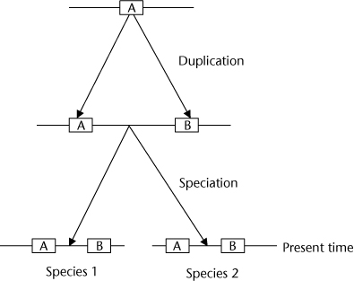
Types of Homologs
Paralogs: duplicate genes within one species
Orthologs: the same gene
within different species
Notes:
Slide 4: A few definitions:
Paralogs are genes that have arisen from duplication within a species – an example is the globin genes that encode the subunits of hemoglobin
Orthologs are ones that are similar between species – an example is the HBB gene, encoding beta-globin in humans and mice.

Slide 5
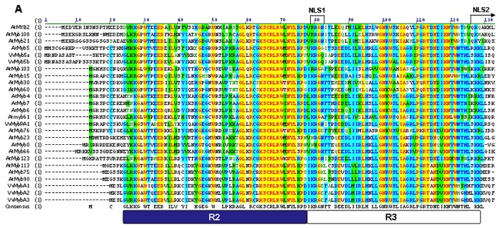
Sequence Conservation
A sequence of amino acids or nucleotides that is similar across species
Pattern of most frequent residues (polypeptide) or bases (DNA or RNA) found at a particular position
Consensus sequence may define a motif of biological significance
Matus JL, et al. (2008). BMC Plant Biol. 8:83
Notes:
Slide 5: Regions of genomes that are important for function, such as protein encoding regions, are likely to be conserved, i.e., having similar sequences in closely related organisms. In the figure shown here, an alignment of a set of transcription factor proteins in the Myb family is documented. The conservation among the sequences is highlighted by the color scheme – yellow meaning conserved in all members, while blue and green means reasonably well conserved. Based on this alignment, the consensus sequence, at the bottom is generated – the amino that occurs most frequently in that spot (column) in the relatives. A blank means that the amino acid in that spot is variable.

Slide 6



Sequence Similarity
sequence database
sequence with known function
sequence with unknown function
extrapolate
function
^{Bordoli L.} “Similarity Searches on Sequence Databases”. Powerpoint presentation. EMBnet Course, Basel, October 2003.
Notes:
Slide 6: Another reason for examining sequence similarity is that by comparing sequences of unknown function to ones that are similar of known function, one can help determine the function of the unknown sequence.

Slide 7
Sequence Alignments
Notes:
Slide 7: Aligning sequences
Note – there is more about this topic in Lesson III – Annotation and especially Lesson IV – Comparative Genomics

Slide 8
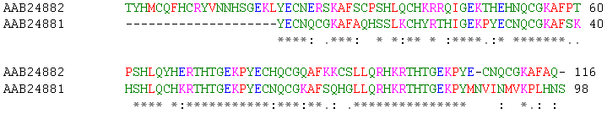
Sequence Alignment
Methods to compare two or more sequences (DNA or protein) to identify characters that are identical or similar in the sequences
Identical or similar characters are placed in the same column
Non-identical characters can be placed either in the same column as a mismatch or opposite a gap
Non-identical characters are placed so as to bring as many identical or similar characters as possible together
Mount D. (2004). Bioinformatics: sequence and genome analysis (Cold Spring Harbor Laboratory Press) pp. 65-120
Notes:
Slide 8: Sequence alignment depends on “counting up” the places where two sequences match. For this protein sequence using this representation, the same amino acid is represented by a ‘*’, a substitution of a closely related amino acid (i.e., E for Q) is represented by a ‘:’, a substitution of a less closely related amino acid (i.e., T for P) is represented by a ‘.’, and a blank shows these two amino acids are not in the same family. The idea is to bring the two sequences in register so that the number of changes between the two sequences in minimized.

Slide 9
Basic Local Alignment Search Tool (BLAST)
Notes:
Slide 9: So how does BLAST actually do this? With two sequences, you can try to align by eye, but there are now millions of sequences in the databases (more about databases in Lesson II). The BLAST algorithm allows for rapid searching of your ‘query’ sequences against the sequences in the database.

Slide 10
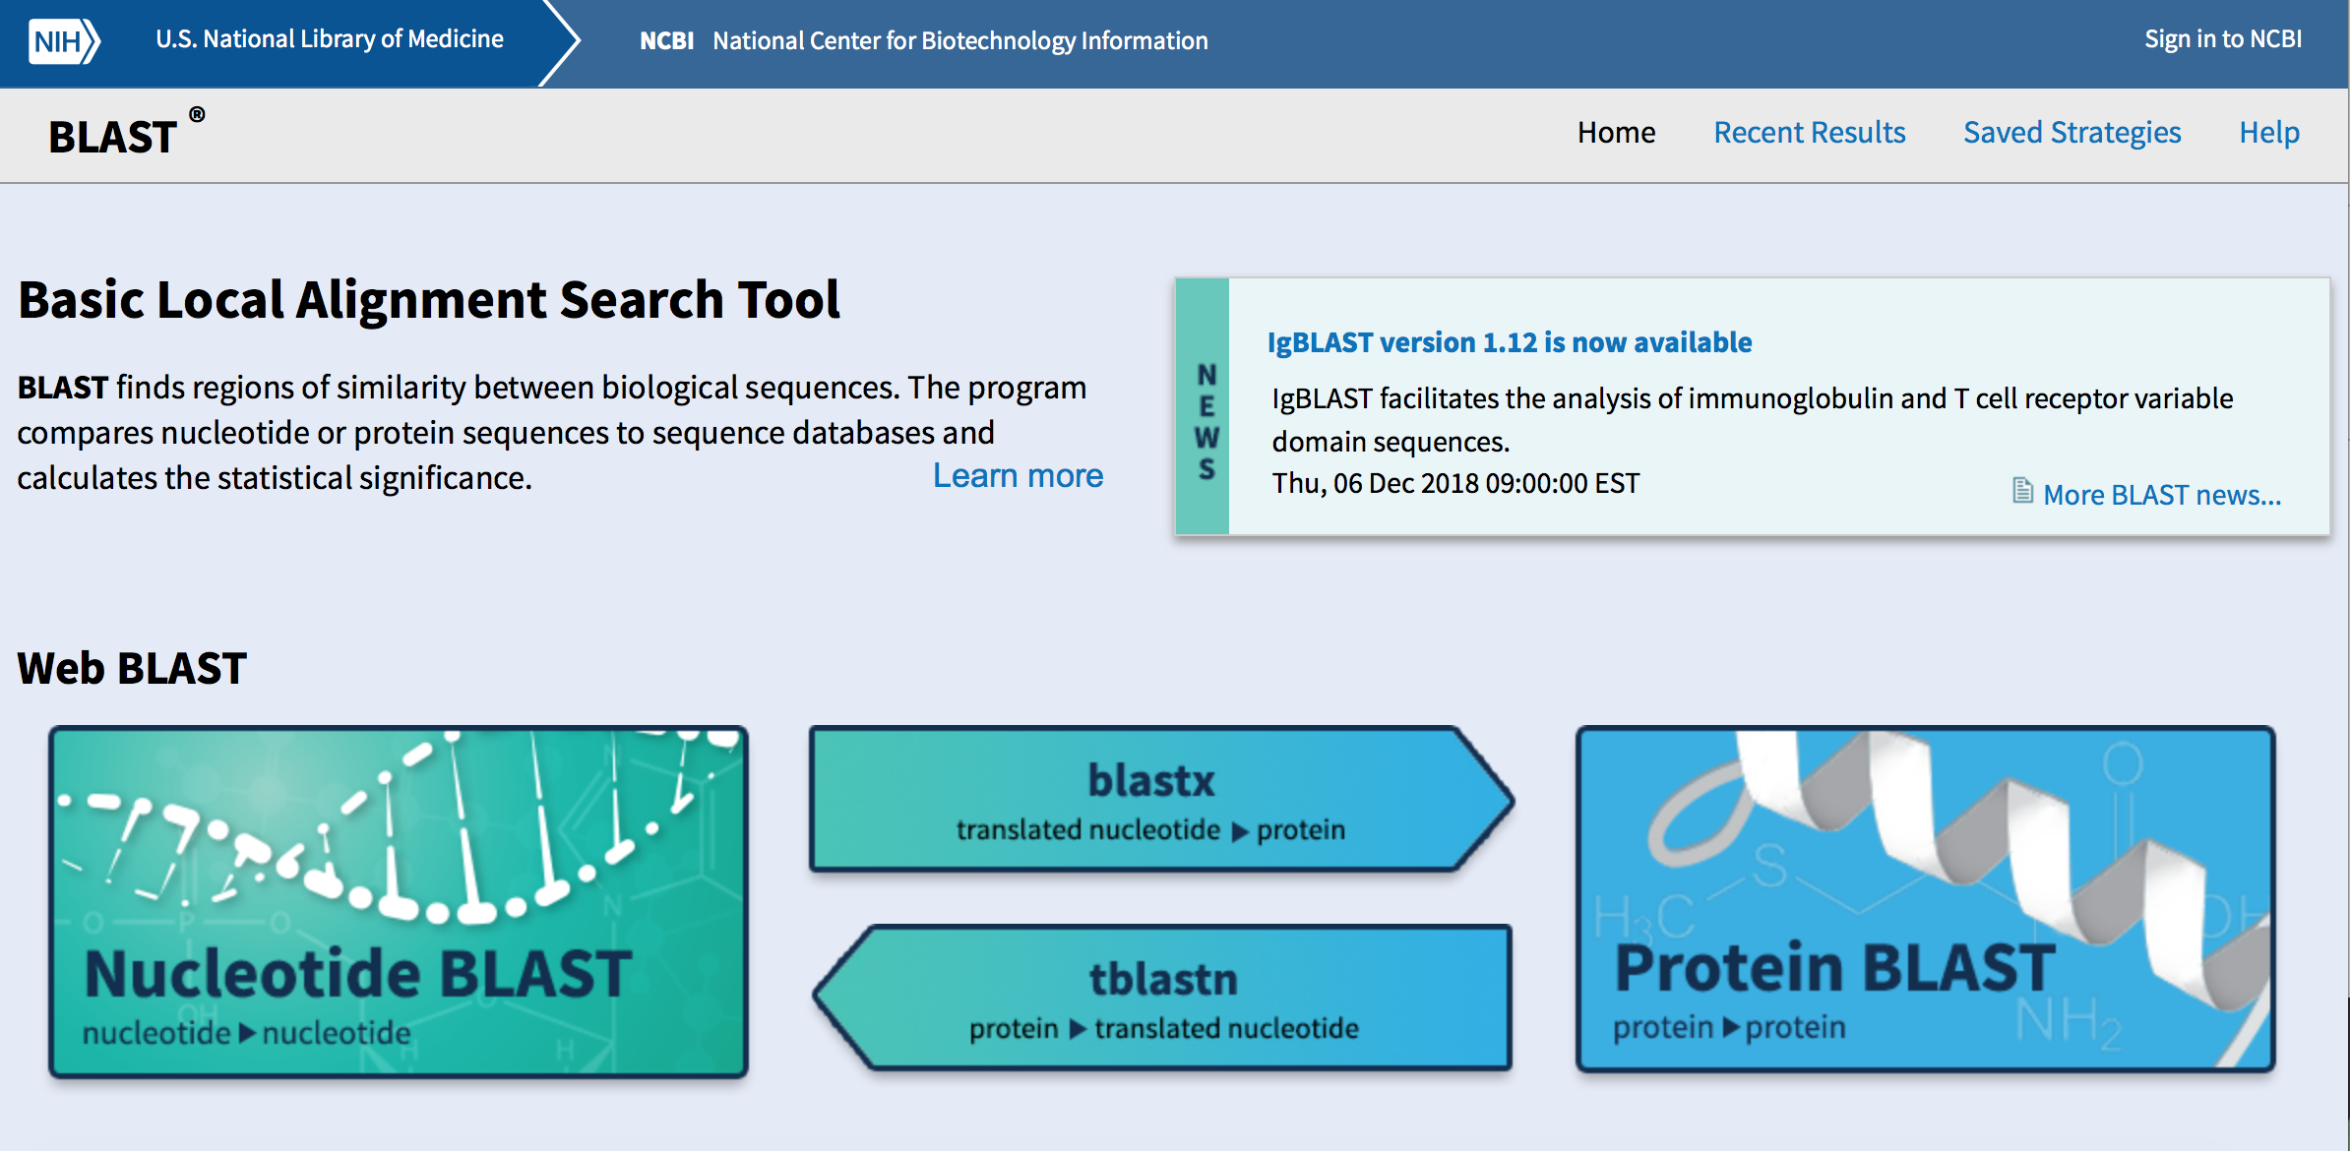
What is BLAST?
Freely available tool compares a protein or DNA sequence to other sequences in various databases
Helps researchers in identifying sequences similar to the query sequence
Helps to infer homology and identify sequences that may be important for function
https://blast.ncbi.nlm.nih.gov/Blast.cgi
Notes:
Slide 10: The BLAST tools is freely available at https://blast.ncbi.nlm.nih.gov/Blast.cgi. There are a number of related tools, but basically one can search for either proteins or nucleotide sequences with either protein or nucleotide sequences.

Slide 11
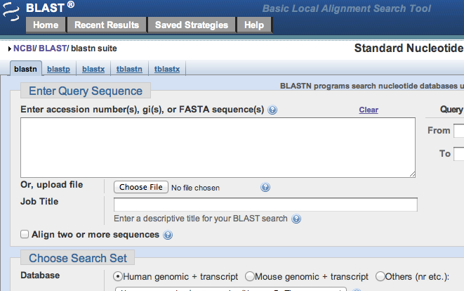
How does BLAST work?
Altschul SF, et al. (1990). J.Mol. Biol. 215: 403
Pevsner J. (2009). Bioinformatics: sequence and genome analysis (Wiley-Blackwell ) pp. 101-140
Notes:
Slide 11: Once you choose the type of BLAST you’re interested in, you’ll get a page that looks like this. In the next several slides, we’ll illustrate the general procedure using a protein sequence.

Slide 12
Phase 1: Compile a List of Words
Example: for a protein query …FSGTWYA…
A list of words from the query sequence (w=3) is:
FSG SGT GTW TWY WYA
For the query word
…FSGTWYA… (in red)
A list of neighborhood words is generated:
GTW (all three the same)
GSW, ATW, NTW, GTY, GNW, etc. (two of the three the same)
Query Words
Notes:
Slide 12: In this example, we’re looking a a protein and breaking it up into words that are 3 letters long (this word length is a parameter that can be determined by the user, but for this example, we’ll say the words are 3 letters long. The entire protein is broken down into overlapping three letter words (bottom left). Then each word is used to generate a list of closely related or ‘neighborhood’ words (using GTW as the example).

Slide 13
Phase 1: Compile a List of Words
GTW 6+5+11 = 22*
neighborhood GSW 6+1+11 = 18
word hits ATW 0+5+11 = 16
> threshold NTW 0+5+11 = 16
(T=11) GTY 6+5+2 = 13
GNW 10
GAW 9
neighborhood word hits below the threshold are eliminated
For the query word
…FSGTWYA… (in red)
Neighborhood words are given a score based on their similarity to the query word
*exact match results in the highest score
Notes:
Slide 13: The matches are then given scores based on how well they match. For proteins we’re taking into account the identity of the amino acid, but also the similarity – for example, replacement of S with T would get a higher score (they’re both hydroxyl containing side chains) than replacement of S with W (a small hydroxyl containing side chain with a bulky aromatic side chain).

Slide 14
Phase 1: Compile a List of Words
The same analysis is then done for all the query words of a certain length (here a length of 3) generated from the
…FSGTWYA… sequence
i.e. … FSG SGT GTW TWY WYA…
Notes:
Slide 14: The same process is repeated for all the overlapping 3-letter words in the protein.

Slide 15
Phase 2: Scan the Database
Each database sequence (subject) is scanned for the words from the list
Query: FSGTWYA
Subject: DMGSWHK
List of neighborhood words:
GTW, GSW, ATW, NTW, GTY, GNW
Notes:
Slide 15: Then the database is scanned to look for words (close matches) from the list.

Slide 16
Phase 3: Extend to Find High Scoring Pairs
KENFDKARFSGTWYAMAKKDPEG 50 RBP (query)
MKGLDIQKVAGSWYSLAMAASD 44 lactoglobulin (hit)
Extend
Extend
Match between the query and the sequence found
The search is extended in either direction to identify high scoring segment pairs (HSPs)
HSPs have are a pair of alignments for which the similarity scores meets or exceeds a threshold
Notes:
Slide 16: Once a match is found, then the word is “extended” to examine the extent to which the two sequences are similar.

Slide 17
Steps Involved in a BLAST Search
Notes:
Slide 17: How to perform a BLAST search

Slide 18
Specify sequence of interest
Select the BLAST program
Select a database
Select optional search parameters
Parameters for blastn
Parameters for blastp
Analyze results
Pick the best hit
Notes:
Slide 18: Initially, one starts with a sequence of interest. The choice of this sequence depends on the question you want to answer.
Sequences can be downloaded from primary nucleotide or protein databases – more about how to acquire sequences in Lesson II – Databases.

Slide 19
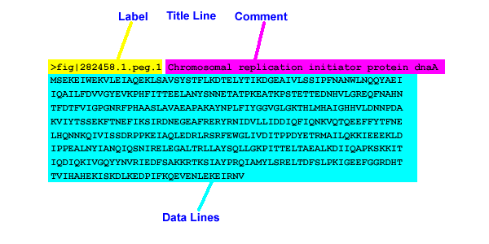
Choose a Sequence of Interest
Query sequences need to be in in FASTA format
Alternatively, query sequences can be denoted by Accession Numbers
Notes:
Slide 19: The sequence input needs to be in a format that the program can understand. More about Accession Numbers in Lesson II – Databases.

Slide 20
Specify sequence of interest
Select the BLAST program
Select a database
Select optional search parameters
Parameters for blastn
Parameters for blastp
Analyze results
Pick the best hit
Notes:
Slide 20: Then one chooses the BLAST program of interest. For this example, we will be using a protein sequence and then using BLASTP to look for similar proteins.

Slide 21
BLAST Interface
From https://blast.ncbi.nlm.nih.gov/Blast.cgi, choose the appropriate BLAST tool.
In this example, we’ll use Protein BLAST or BLASTp
Notes:
Slide 21: Working with the BLAST interface

Slide 22
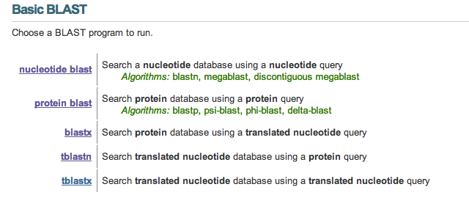
BLAST Interface
Notes:
Slide 22: There are a number of different versions of BLAST, using either nucleotide or protein sequence data and comparing to either nucleotide or protein sequence databases. In addition, there are different versions that take into account the evolutionary distance you’re wanting to cover in your search (i.e., are you look for the rat ortholog of a mouse protein? or are you looking for the yeast ortholog of a mouse protein?).
Blastp compares a protein query to a database of proteins
Blastn compares a nucleotide query to a database of nucleotides
Blastx translates the DNA into six protein sequences using all reading frames and compares them to a protein database-if you have a DNA sequence and you want to know what protein it encodes
tBlastn compares a protein query sequence against a nucleotide sequence database dynamically translated into all reading frames- does a protein query yield any matches in a database of genomic DNA fragments from the genome sequencing project of a particular organism.
tBlastx compares the 6 frame translations of a nucleotide query against the 6 frame translations of a nucleotide sequence database

Slide 23
BLAST Interface
Click on “Protein BLAST” to get this page
Paste the sequence of interest (either FASTA format or Accession Number) into the box
Click the blue BLAST button (scroll down)
Notes:
Slide 23: Performing a BLAST search is easy, simply paste the sequence into the box and hit submit.

Slide 24
Program Selection for blastn – Nucleotide Analysis
Megablast - compares query to closely related sequences; optimal if sequence identity is 95% or higher – the choice when searching for highly similar sequences
Discontiguous blast - uses discontiguous words; better for cross-species comparisons – works for more dissimilar sequences
Blastn - searches most of the nucleotide databases – less similar sequences
Zhang Z, et al. (2000). J.Comp.Biol. 7: 203
Ma B, et al. (2002). Bioinformatics. 18: 440
Notes:
Slide 24: Some additional details for nucleotide blast programs

Slide 25
Program Selection for blastp
Blastp - searches a database to find similar sequences for a query amino acid sequence
Protein-Specific Iterated BLAST (PSI-BLAST) - more sensitive; used to identify distantly related proteins
Pattern-Hit Initiated BLAST (PHI-BLAST) - used to search for proteins that contain a pattern designated by the user
Other versions also available – see the BLAST website for more
Altschul SF, et al. (1997). Nucleic Acids Res. 25: 3389
Zhang Z, et al. (1998). Nucleic Acids Res. 26: 3986
Boratyn GM, et al. (2012). Biol Direct. 17: 12
Notes:
Slide 25: Some additional details for protein BLAST versions

Slide 26
Specify sequence of interest
Select the BLAST program
Select a database
Select optional search parameters
Parameters for blastn
Parameters for blastp
Analyze results
Pick the best hit
Notes:
Slide 26: Once you’ve chosen the type of analysis you’d like to perform, the next step is to choose a database.

Slide 27
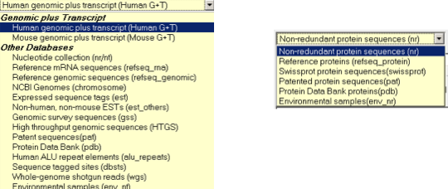
Selecting a Database
nr/nt: non-redundant nucleotide database (most general database) or est database – this is the default choice
nr: non redundant protein database or swiss-prot database
protein databases
nucleotide databases
Notes:
Slide 27: There are a number of different databases to choose from. These are available via pull-down menus on the query page.

Slide 28
Specify sequence of interest
Select the BLAST program
Select a database
Select optional search parameters
Parameters for blastn
Parameters for blastp
Analyze results
Pick the best hit
Notes:
Slide 28: Next, you have the ability to modify your search parameters from the default settings. The default works well if you’re looking for sequences that are relatively close (i.e., you’re looking for other mammalian sequences or perhaps other vertebrates, but not invertebrates).

Slide 29
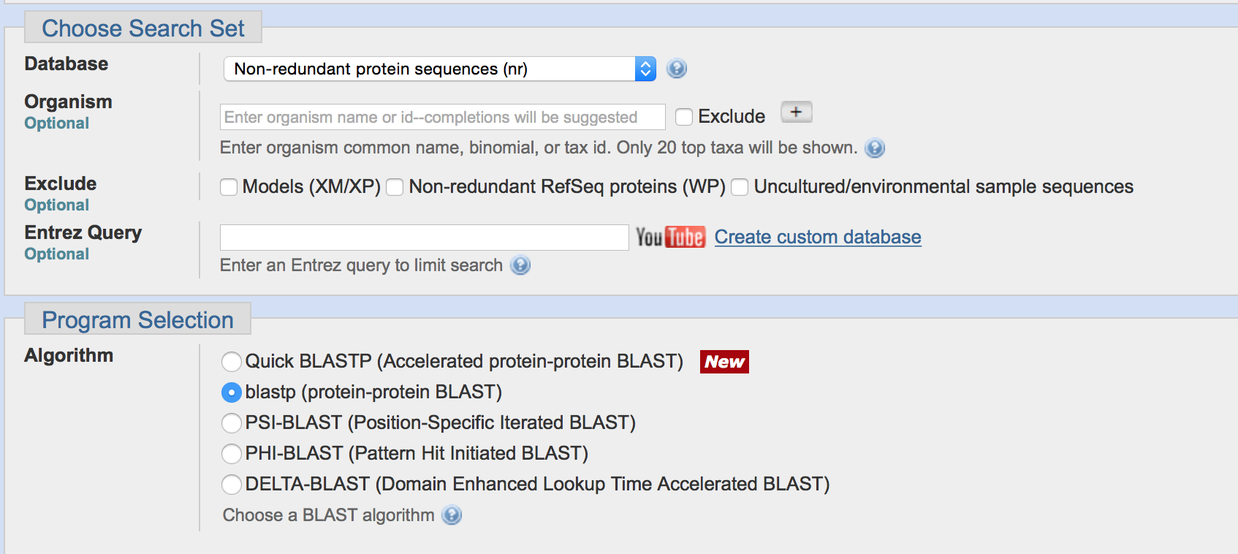
BLAST Interface
Notes:
Slide 29: However it pays to know something about how the algorithm works to get the results most appropriate to your question. There are a number places where the user can alter the default settings. These include the database, the organism(s), exclusions, and the Program Selection.
In addition, it’s possible to alter the default algorithm parameters by expanding the +algorithm parameters under the BLAST submit button. Parameters include number of target sequences, the score, the word size, the scoring matrix, etc. More about the matrices used in Lesson IV – Comparative Genomics.
In other words, there’s more to this than simply entering your sequence and “BLASTing.”

Slide 30
Optional Parameters for blast
Change the word size and threshold, number of entries to be displayed, improve results for short entries and display only strong matches
Change the scoring parameters
Filter for regions that may not be biologically interesting or filter for sequence repeats
Masking, so that extension phase goes through low complexity regions or mask for designated regions of the query sequence which are in lower case
Notes:
Slide 30: Some of the other options in more detail.

Slide 31
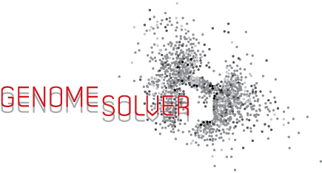
Specify sequence of interest
Select the BLAST program
Select a database
Selecting optional search parameters
Parameters for blastn
Parameters for blastp
Analyze results
Pick the best hit
Notes:
Slide 31: Now – how to analyze the results? Once you’ve submitted a sequence to the program, you’ll end up with a new page with details to interpret.

Slide 32
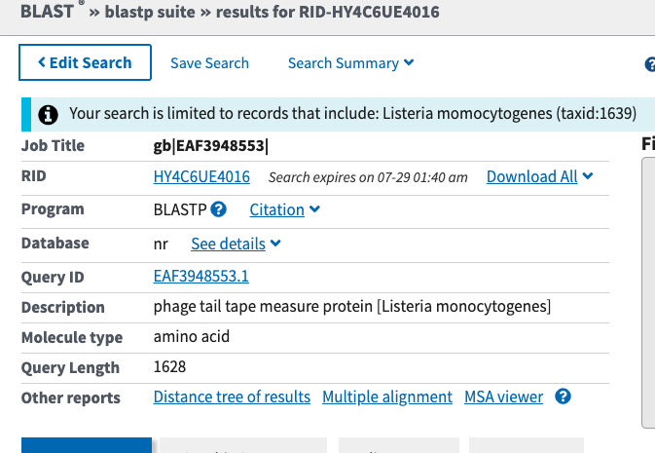
BLAST Results
Query information
Database and BLAST information
Notes:
Slide 32: At the top of the page is a reiteration of what you’ve told the program to do (red ovals). Next comes a graphic that tells you matches. The best matches are red, then pink, and so on.

Slide 33
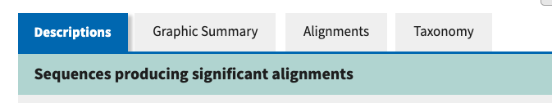
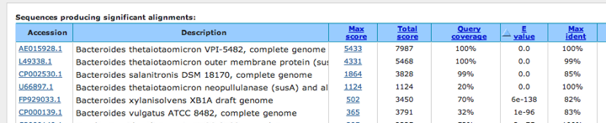
BLAST Results – Accession Numbers
Accession Number: NCBI record
Notes:
Slide 33: Scrolling down below the graphic on the previous slides reveals a table. This table has a lot of information that this useful. At left is the NCBI Accession Number assigned to each sequence pulled up from the database as a match. More about Accession Numbers in Lesson II – Databases

Slide 34
BLAST Results – Accession Numbers
Sequence Description
Notes:
Slide 34: Scrolling down below the graphic on the previous slides reveals a table. This table has a lot of information that this useful. At left is the NCBI Accession Number assigned to each sequence pulled up from the database as a match. More about Accession Numbers in Lesson II – Databases

Slide 35
BLAST Results – Scores
Score: In context of an alignment, a score describes the overall quality of the alignment. Higher numbers correspond to higher similarity
Raw score: is calculated from the substitution matrix and parameters used to assess the pair-wise alignments
Max score (bit score): is calculated from the raw score by normalizing with the statistical variables that define a given scoring system
Total score: includes score from non-contiguous portions of the subject sequence that match the query sequence
Notes:
Slide 35: At the right are a series of scores. The best hit is always the first one. It has the highest max score and the lowest e-value. Depending on the database chosen, this might be the original query sequence (in other words, if the query is in the database, then it will find itself as a perfect match).

Slide 36
BLAST Results – Query Coverage
Fraction of the query sequence that matches the subject sequence
Notes:
Slide 36: Sometimes the match does not extend for the entirety of the query. Depending on your question, this might be an important feature to consider.

Slide 37
BLAST Results – E-value and Maximum Identity
E-value is a probability score conveying the likelihood the match is a coincidence; the lower the e-value the better
Match to the subject sequence with the higher percentage of identical bases
Notes:
Slide 37: The last two parameters are E-value and Max Identity.

Slide 38
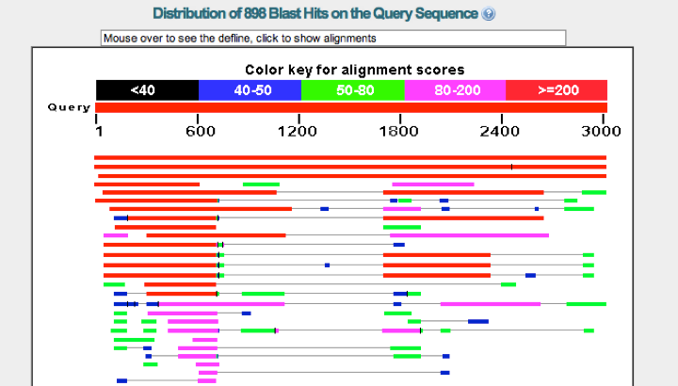
BLAST Results
{
Alignment scores
Query Sequence
Matches
Notes:
Slide 38: At the top of the page is a reiteration of what you’ve told the program to do (red ovals). Next comes a graphic that tells you matches. The best matches are red, then pink, and so on.

Slide 39
BLAST Results
Match
Length
Location
Notes:
Slide 39: From this example, we can see that there are several hits that match very well over the entire length, but lower on the graphic are matches that begin to lose some of the material in the middle, and then even lower, change color.

Slide 40
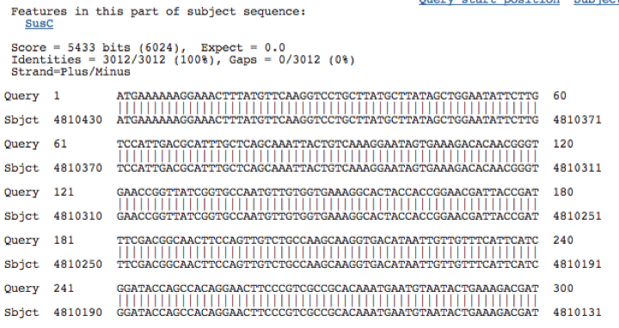
BLAST Results – Alignment
Bit score
Raw score
Gap information
Identities
between query and subject
In the case of a protein alignments, identical matches are marked by the letter code and homologous matches by a ‘+’ symbol in between the alignments
Notes:
Slide 40: Scrolling down below the table reveals the individual matches between the hits in the table and the query sequence. Some of the information from the table is repeated, but in addition, there are details that are specific to this graphic (identities, gaps, etc.)

Slide 41
BLAST Results – Alignment
Bit score
Raw score
Gap information
Orientation
Identities
between query and subject
Co-ordinates for query and subject sequence
Notes:
Slide 41: Another important feature to note is where the query matches the subject. This could be important if you need to map the match onto the chromosome.

Slide 42
Specify sequence of interest
Select the BLAST program
Select a database
Select optional search parameters
Parameters for blastn
Parameters for blastp
Analyze results
Pick the best hit
Notes:
Slide 42: Picking the best hit could simply involve scrutinizing the data to make sure the line at the top is not the query itself. However, again, depending on the question posed, the interpretation may be more involved than this simple example.

Slide 43
Interpret the Results
Best hit is listed at the top
Smaller the E-value associated with the alignment, there are fewer chances that you will find another alignment with the score S or better
Higher the Bit score associated with the alignment, there is a greater similarity based on the scoring matrix
Look out for the query coverage and make sure it matches the original query sequence
Compare protein structures, look out for common domains, part of a multiple sequence alignment
Notes:
Slide 43: Some additional considerations for choosing how to interpret the data.

